Slide 1

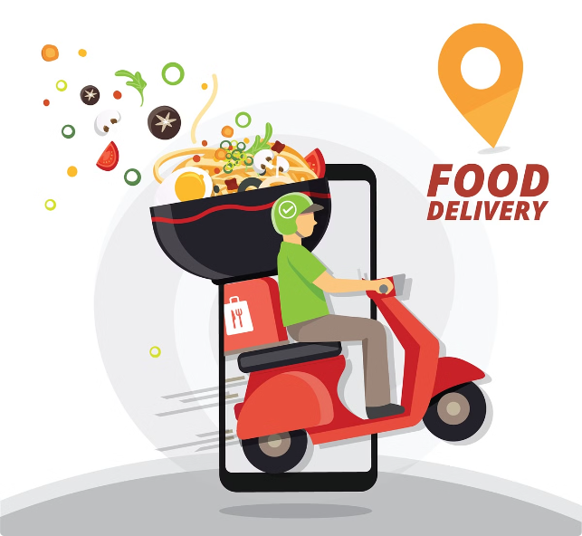


Introduction to Swiggy's Food Delivery Analysis
Swiggy, India's leading food delivery platform, has revolutionized the way people access and consume food in the country. Through comprehensive data analysis, this presentation delves into the trends and insights surrounding food delivery demand across some of India's major metropolitan cities, including Mumbai, Bangalore, Kolkata, Chennai, Pune, Delhi, Ahmedabad, Hyderabad, and Surat. By exploring the unique dynamics and preferences of each region, this in-depth report aims to provide a holistic understanding of the evolving food delivery landscape in India.
by Akash Hari

Slide 2
Overview of the Major Indian Cities Covered
Mumbai
Bangalore
Kolkata
The financial capital of India, Mumbai is known for its bustling streets, diverse cuisines, and a thriving food delivery industry. With a population of over 20 million, the city's demand for convenient and reliable food delivery services continues to grow.
Often referred to as the "Silicon Valley of India," Bangalore is a hub of technological innovation and a rapidly growing food delivery market. The city's cosmopolitan population and diverse culinary offerings have contributed to the increasing popularity of food delivery platforms.
The cultural capital of India, Kolkata boasts a rich culinary heritage and a vibrant food delivery scene. The city's love for traditional Bengali cuisine, as well as its growing appetite for global flavors, has made it an intriguing market for food delivery platforms.

Slide 3
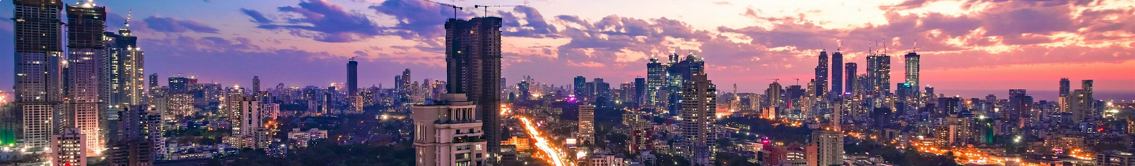
Trends in Food Delivery Demand in Mumbai
Surge in Demand
Convenience and Reliability
Mumbai, known for its bustling streets and diverse culinary offerings, has witnessed a significant surge in food delivery demand in recent years. The city's busy lifestyle and the rise of dual-income households have contributed to the growing popularity of convenient and time-saving food delivery services.
The convenience and reliability of food delivery services have become a crucial factor in Mumbai's food landscape. Customers now expect seamless ordering processes, prompt delivery, and high-quality food, driving food delivery platforms to continuously improve their operations and customer experience.
1
2
3
Evolving Preferences
Mumbaikars have become increasingly discerning in their food choices, seeking a wider range of cuisine options, from traditional Maharashtrian dishes to global delicacies. Food delivery platforms have responded by expanding their menus and partnering with a diverse range of restaurants to cater to these evolving preferences.

Slide 4
Trends in Food Delivery Demand in Bangalore
Tech-Savvy Clientele
Diverse Cuisine Offerings
Healthy Eating Trends
Bangalore, known as the "Silicon Valley of India," is home to a highly tech-savvy population that has embraced food delivery services with enthusiasm. The city's young, working professionals and entrepreneurs have become increasingly reliant on these platforms to cater to their busy lifestyles and diverse culinary preferences.
Bangalore's food delivery landscape reflects the city's cosmopolitan nature, with a wide range of cuisine options available to customers. From traditional South Indian dishes to international cuisines, food delivery platforms have partnered with a diverse array of restaurants to meet the city's evolving culinary demands.
Bangalore's health-conscious population has also influenced the food delivery industry, with a growing demand for nutritious and sustainable meal options. Food delivery platforms have responded by expanding their offerings to include healthier choices, catering to the city's increasing focus on wellness and mindful eating.

Slide 5

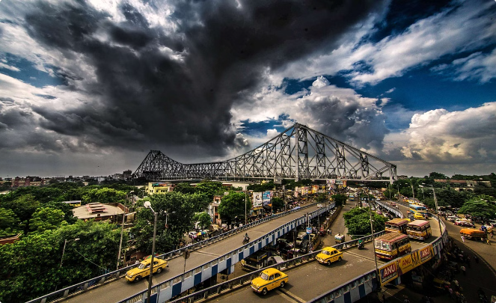
Trends in Food Delivery Demand in Kolkata
1
Embrace of Traditional Cuisines
2
Evolving Palates and Global Flavors
Kolkata, known as the cultural capital of India, has a deep-rooted love for traditional Bengali cuisine. Food delivery platforms have recognized the importance of catering to this demand, partnering with local establishments that specialize in authentic regional dishes to cater to the city's culinary preferences.
While traditional Bengali cuisine remains a mainstay, Kolkata's food delivery landscape has also seen a growing interest in global cuisines. Customers are increasingly exploring international flavors, driving food delivery platforms to expand their menus and partner with a diverse range of restaurants to satisfy this evolving demand.
3
Convenience and Affordability
Kolkata's food delivery market is characterized by a strong emphasis on convenience and affordability. Customers seek efficient service and value-for-money offerings, pushing food delivery platforms to optimize their operations and tailor their pricing to meet the city's unique needs.

Slide 6

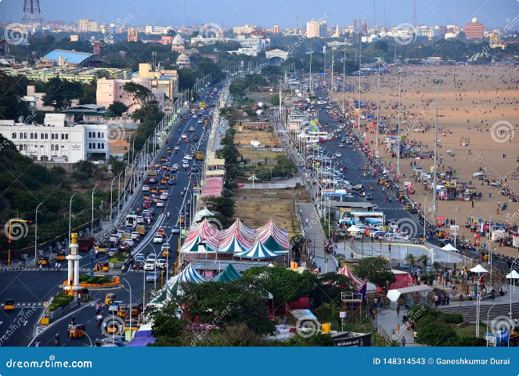
Trends in Food Delivery Demand in Chennai
Preference for Local Flavors
Evolving Dietary Preferences
Chennai, the capital of Tamil Nadu, is renowned for its rich culinary heritage and the deep-rooted love for traditional South Indian cuisine. Food delivery platforms in the city have capitalized on this demand, partnering with local restaurants that specialize in authentic Tamil dishes to cater to the city's discerning palate.
While traditional South Indian cuisine remains a staple, Chennai's food delivery market has also witnessed a growing demand for healthier and more diverse meal options. Customers are increasingly seeking vegetarian, vegan, and gluten-free offerings, prompting food delivery platforms to expand their menus and collaborate with restaurants that cater to these evolving dietary preferences.
Convenience and Reliability
Evolving Consumer Trends
Convenience and reliability are key factors driving the growth of food delivery in Chennai. Customers expect efficient order processing, prompt delivery, and high-quality food, leading food delivery platforms to continuously improve their operational capabilities and customer experience to meet these demands.
The food delivery market in Chennai is also influenced by broader consumer trends, such as the rise of online ordering, the growing popularity of contactless delivery, and the increasing demand for sustainable and eco-friendly packaging. Food delivery platforms must stay attuned to these evolving preferences to maintain their competitiveness in the local market.

Slide 7
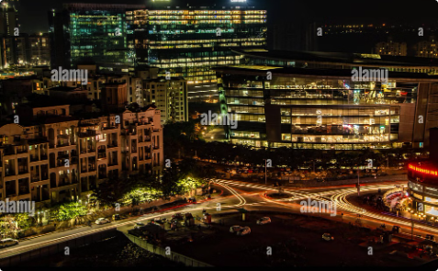
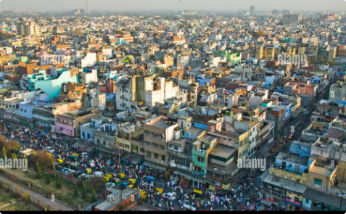

Trends in Food Delivery Demand in Pune, Delhi, and Ahmedabad
Pune
Delhi
Ahmedabad
Pune, a rapidly growing city in Maharashtra, has witnessed a surge in food delivery demand driven by its young, tech-savvy population and the rise of the IT and education sectors. Customers in Pune have shown a preference for diverse cuisine options, healthy meal choices, and efficient delivery services.
As the national capital, Delhi's food delivery market is characterized by a diverse customer base, ranging from working professionals to families. The city's love for street food and traditional North Indian cuisine has influenced the offerings of food delivery platforms, which have also expanded to cater to the growing demand for global flavors.
Ahmedabad, the commercial hub of Gujarat, has seen a steady growth in food delivery demand, driven by its vibrant culinary scene and the increasing preference for convenience. The city's diverse population, with its distinct food preferences and dietary requirements, has challenged food delivery platforms to offer a wide range of options to cater to these unique needs.

Slide 8

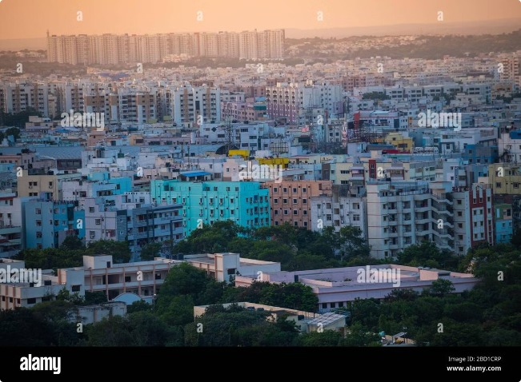


Trends in Food Delivery Demand in Hyderabad and Surat
Hyderabad
Surat
Hyderabad, the capital of Telangana, is known for its rich culinary heritage and the popularity of its traditional Hyderabadi cuisine. Food delivery platforms in the city have capitalized on this demand, partnering with local restaurants that specialize in authentic Hyderabadi dishes while also catering to the growing interest in global flavors.
Surat, the commercial hub of Gujarat, has witnessed a steady growth in food delivery demand, driven by its diverse population and the increasing preference for convenience. The city's food delivery market reflects a blend of traditional Gujarati cuisine and a growing interest in international flavors, as food delivery platforms cater to the evolving preferences of their customers.

Slide 9
conclusion
Swiggy is one of the India’s most valuable and largest online food delivery platforms. Since its launch, the business has managed to grow at rapid pace and generate a large amount of money for its firm. Starting from online menus to massive delivery, Swiggy has covered majority of the path towards success. It is now the highest preferred online platform for food delivery and has gained the top position in this market. It is regularly working on improvements and launching technical advancements on regular intervals to improve experience and value to their business. Swiggy has introduced many exciting features like Swiggy Access, Swiggy Pop and Swiggy Schedule etc. The main target customers for Swiggy are those who do not want to move out or visit restaurants and enjoy having delicious food at home without making efforts. They want their food easily readily available at their door step.
Swiggy in future will be able to capture the Market of almost all the cities of the nation. The business is expected to grow further as it has not stopped changing its strategies. The business is continuously changing according to the need of the environment and is trying to improve the experiences. In order to cover the cost it has also established partnership with many banks and financial institutes which help it to generate more income apart from their core business. The dynamic view of business looking 360 degree into its environment has helped Swiggy to gain this position but maintaining position is also a major task as Swiggy is now continuously facing Competition from many other competitors like Food panda, Zomato and Uber eats.

